Slide 1
TASK-2
Finding all possible vulnerabilities and loopholes in : http://zero.webappsecurity.com/ using Netsparker

Slide 2
Found Out-of-date Version (OpenSSL) Domain: http://zero.webappsecurity.com Steps to reproduce : Step 1: Add http://zero.webappsecurity.com/ the dialogue box. Step 2: Define the customization option to scan as per your need Step 3: It will start scanning it automatically Impact: Since this is an old version of the software, it may be vulnerable to attacks. When using an expired certificate, you risk your encryption and mutual authentication. As a result, both your website and users are susceptible to attacks and viruses. Identified Version 0.9.8e (contains 5 critical and 107 other vulnerabilities) Latest Version is 1.1.1k Vulnerability Details: Netsparker identified that http://zero.webappsecurity.com/ is using an out-of-date version of OpenSSL. OpenSSL is a robust, commercial-grade, and full-featured toolkit for the Transport Layer Security (TLS) and Secure Sockets Layer (SSL) protocols. It is also a general-purpose cryptography library. For more information about the team and community around the project, or to start making your own contributions. http://zero.webappsecurity.com/ is using 0.9.8e version of OpenSSL which contains 5 critical and 107 other kind of vulnerabilities

Slide 3
Some Vulnerabilities like these listed below can seriously harm our user data and has potential threat to the website and server 1.)OpenSSL Numeric Errors Vulnerability Off-by-one error in the DTLS implementation in OpenSSL 0.9.8 before 0.9.8f allows remote attackers to execute arbitrary code via unspecified vectors. 2.)OpenSSL Improper Input Validation Vulnerability OpenSSL before 0.9.8m does not check for a NULL return value from bn_wexpand function calls in (1) crypto/bn/bn_div.c, (2) crypto/bn/bn_gf2m.c, (3) crypto/ec/ec2_smpl.c, and (4)engines/e_ubsec.c, which has unspecified impact and context-dependent attack vectors. 3)OpenSSL Improper Input Validation Vulnerability Memory leak in the tls_decrypt_ticket function in t1_lib.c in OpenSSL before 0.9.8zc, 1.0.0 before 1.0.0o, and 1.0.1 before 1.0.1j allows remote attackers to cause a denial of service (memory consumption) via a crafted session ticket that triggers an integrity-check failure. 4)OpenSSL Improper Authentication Vulnerability OpenSSL before 1.0.0c, when J-PAKE is enabled, does not properly validate the public parameters in the J-PAKE protocol, which allows remote attackers to bypass the need for knowledge of the shared secret, and successfully authenticate, by sending crafted values in each round of the protocol. 5)OpenSSL Resource Management Errors Vulnerability Double free vulnerability in OpenSSL 0.9.8 before 0.9.8s, when X509_V_FLAG_POLICY_CHECK is enabled, allows remote attackers to have an unspecified impact by triggering failure of a policy check.

Slide 4
6)OpenSSL Cryptographic Issues Vulnerability The Cryptographic Message Syntax (CMS) implementation in crypto/cms/cms_asn1.c in OpenSSL before 0.9.8o and 1.x before 1.0.0a does not properly handle structures that contain OriginatorInfo, which allows context-dependent attackers to modify invalid memory locations or conduct double-free attacks, and possibly execute arbitrary code, via unspecified vectors. 7)OpenSSL Improper Restriction of Operations within the Bounds of a Memory Buffer Vulnerability The ASN.1 implementation in OpenSSL before 1.0.1o and 1.0.2 before 1.0.2c allows remote attackers to execute arbitrary code or cause a denial of service (buffer underflow and memory corruption) via an ANY field in crafted serialized data, aka the "negative zero" issue. Mitigations: If you want to prevent the website from being vulnerable please upgrade your installation of OpenSSL to the latest stable version. You can do this by performing following steps Step 1 – Download OpenSSL Binary Step 2 – Run OpenSSL Installer Step 3 – Setup Environment Variables Step 4 – Run OpenSSL Binary POC including screenshots are attached in the report.

Slide 5
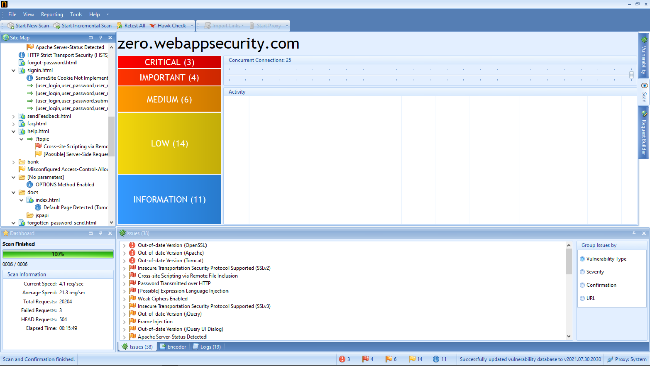
Page -1

Slide 6
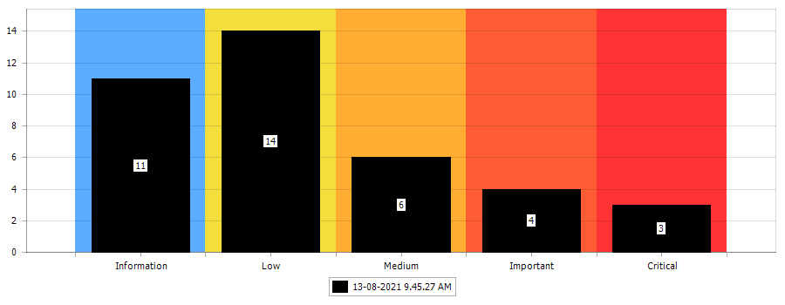

Slide 7
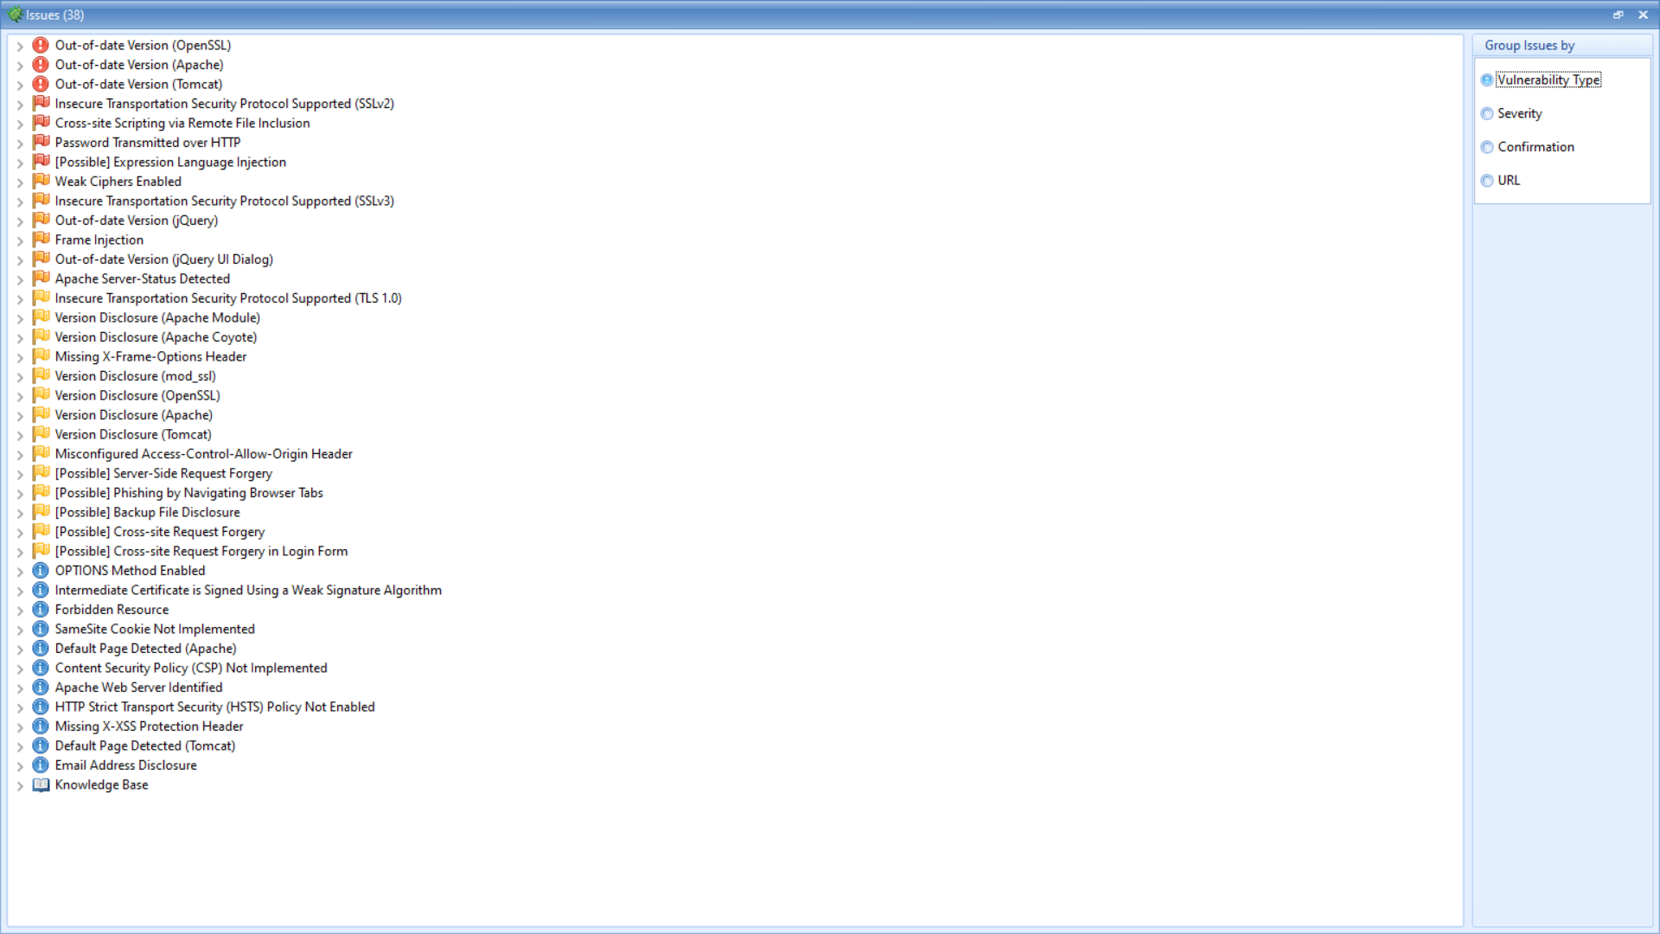

Slide 8
